Slide 1
Session 6
Designing the System

Slide 2
Review
A data model is a formal representation, which hides uninteresting details, highlights important facts, and gives a better understanding of the system to be built.
A representation of information that has a number of different properties or attributes and that can be understood by software, is called a data object.
Attributes define the properties of a data object and may serve one of the following purposes:
  To name an instance of the data object
  To describe the instance
  To make references to another instance in another table
Relationships are verbs used to indicate actions between any two data objects in the system.
Cardinality defines the maximum number of object-relationships that can participate in an association or relationship.

Slide 3
Review Contd…
The modality of a relationship is zero if there is no explicit need for the relationship to occur or the relationship is optional. The modality is one if an occurrence of the relationship is mandatory.
An Entity-Relationship diagram identifies a number of components such as data objects, attributes, relationships and various type-indicators. The main objective of the ERD is to represent data objects and their relationships.
Data flow diagrams are typically used to represent a system or software at any level of abstraction.
Data flow diagrams provide mechanisms for function modeling as well as information flow modeling.
A Control Flow Diagram contains the same processes as the DFD but shows more control flow instead of data flow.
A data dictionary is a centralized collection of definitions of all the data flowing to or from data stores and/or processes.

Slide 4
Objectives
Describe the design process
Describe the principles of design
Describe the software design concepts
Describe the following design tools:
  Structure chart
  Structured flowchart
  Structured English

Slide 5


The Design Process
Definition: The process of applying various techniques and principles for defining a device, process or system in detail to permit its physical realization.

Slide 6
Steps in the Design Process
Architectural Design
Interface Design
Procedural Design

Slide 7
Key Issues in the Design Process
It is an iterative process.
What are the guidelines for the evaluation of a good design?
What are the technical criteria to establish a good design?

Slide 8
Design Principles
Avoid tunnel vision.
Make the design model traceable to the analysis model.
Do not reinvent the wheel.
Minimize the intellectual distance.
Exhibit uniformity and integration.
Structure the design to accommodate change.
Structure the design to avoid sudden and abrupt breakdown.
Assess the quality as it is being created.
Review to minimize conceptual errors.

Slide 9
Design Concepts
Abstraction
  Procedural Abstraction
  Data Abstraction
  Control Abstraction
Stepwise refinement
  Decomposing design decisions to elementary levels
  Separating design aspects that are not truly interdependent
  Postponing decisions concerning representation details as long as possible
  Demonstrating carefully that each successive step is an expansion of the previous steps

Slide 10
Design Concepts Contd…
Modularity
Software architecture
Control hierarchy
  Visibility
  Connectivity
Structural partitioning
  Horizontal
  Vertical

Slide 11
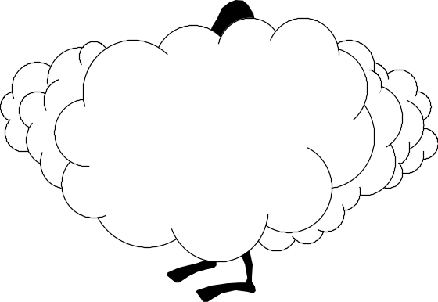
Design Concepts Contd…
Data structure
Software procedure
Information hiding
Information hiding

Slide 12
Structured Design
Structured design involves:
  Coupling
  Cohesion

Slide 13
Coupling
Definition: It refers to the strength of the relationship between modules in a system.
It is a structured design concept.
Good design involves loosely coupled modules.
Coupling
Coupling
Coupling

Slide 14
Types of Coupling
Content coupling (worst)
Common coupling
Control coupling
Stamp coupling
Data coupling (best)

Slide 15
Cohesion
Definition: It refers to the strength of the relationship between elements of the same module in a system.
It is a structured design concept.

Slide 16
Types of Cohesion
Coincidental (worst)
Logical
Temporal
Communication
Sequential
Informational
Functional (best)

Slide 17
Design Tools
Structure charts
Structured flowchart
Structured English

Slide 18
Structure Charts
Definition: They are graphical descriptions that show the data exchanges between modules that interact with each other.
It uses the Logical DFDs from the analysis stage as a base.
It has no decision boxes.
It can omit the sequential ordering of tasks inherent in a flowchart.

Slide 19
Structure Charts – Common Notations
Calling
Module
Called
Module
Arrow Call Symbol
Module Symbol
Sender
Receiver
Data Couple Symbol
Decision Symbol
Sender
Receiver
Control Flag Symbol
Loop Repetition Symbol

Slide 20
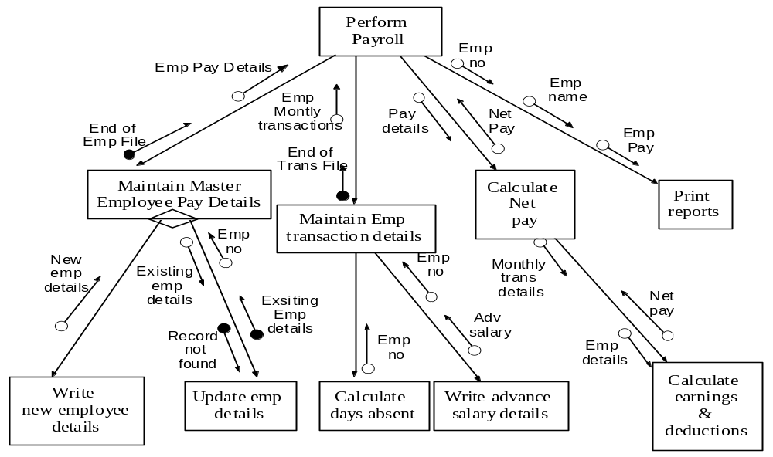
Structure Chart – An Example
Notes:
Spelling mistake in the word “monthly transactions”

Slide 21
Structured English
It can be used to provide systematic specification for an algorithm.
It is similar to a pseudo code.

Slide 22
Structured English - Characteristics
A predetermined syntax of keywords must provide for all structured constructs, data declarations and modularity characteristics.
A free syntax of natural language like English that describes processing features.
Data declaration facilities that should include both simple (scalar, array) and complex (linked list) data structures.

Slide 23
Structured English – An Example
For each MEMBER ID in the MEMBERS file repeat the steps below
If RETURN DATE is greater than DUE DATE
Calculate FINE for the number of extra days
Print the Fine Bill

Slide 24
Structured Flowcharts
Definition: They are used to specify and document sequence of steps to solve a problem. However, they are restricted to using only certain basic forms.
Express control flows with more clarity than the pseudo code.

Slide 25
Structured Flowcharts – Basic Symbols
Start Symbol
End Symbol
Process Symbol
Decision Block

Slide 26
Structured Flowcharts – Basic Structures
If-then-else
Sequence

Slide 27
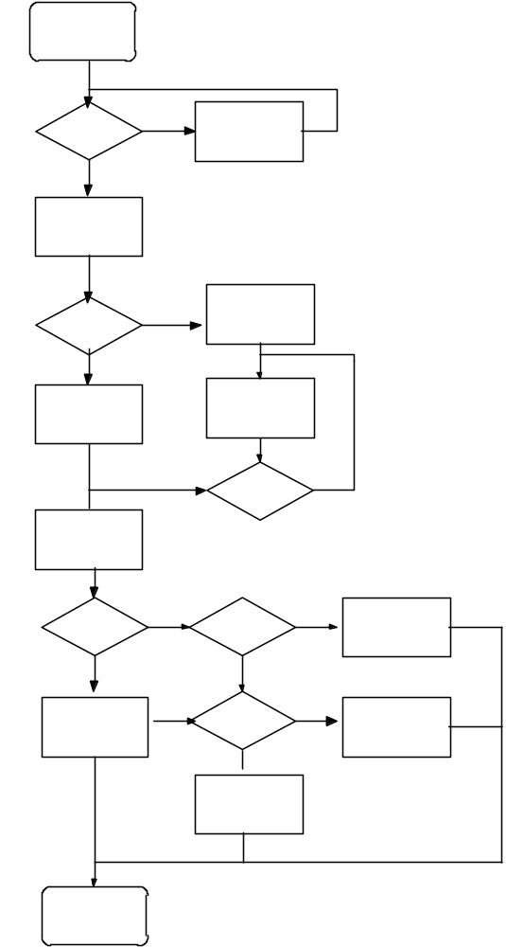
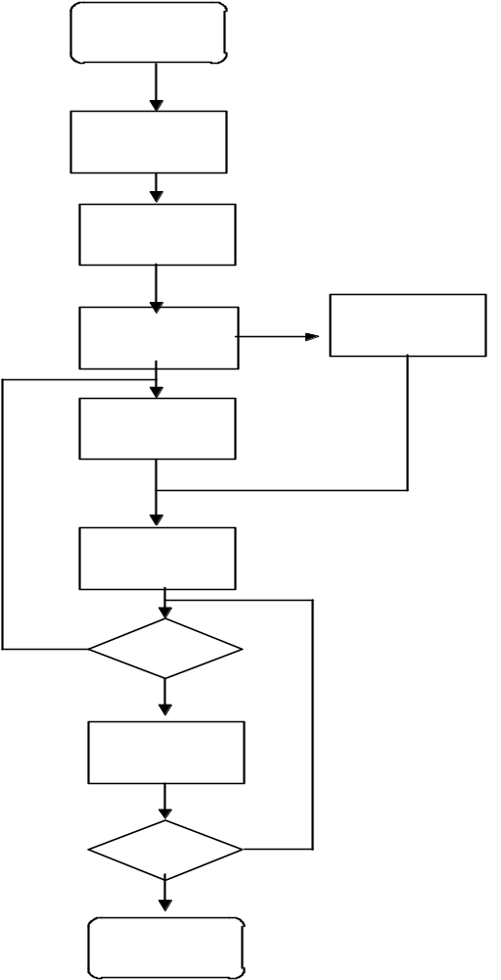
Structured Flowcharts – An Example and a Comparison
Structured
Flowchart
Unstructured
Flowchart

Slide 28
Summary
Software design is situated at the core of the software engineering process and is always applied irrespective of the software process model used.
The design model comprises of data design, architectural design, interface design and procedural design.
The information domain model created during analysis is transformed by data design into the data structures necessary to implement the software.
Interface design describes how software communicates within itself to systems that interoperate within it and with persons who use it.
Procedural design transforms structural elements of the program architecture into a procedural description of software components.
Design is an iterative process during which requirements are translated into an outline for constructing the software.

Slide 29
Summary Contd…
Vital design concepts include:
  Abstraction
  Stepwise refinement
  Modularity
  Software architecture
  Control hierarchy
  Structural partitioning
  Information Hiding
Coupling refers to the strength of the relationship between modules in a system, and is determined by the data passes between modules and the interdependence between the modules.
Cohesion refers to the strength of the relationship between elements of the same module in a system. It represents how tightly bound the internal elements of the module are to one another.
Standard tools used for design are structure charts, structured English, and structured flowcharts.

